Slide 1
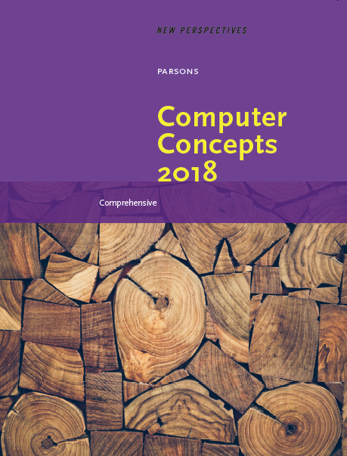

Computer Concepts 2018
Module 1
Digital Content
Copyright © 2019 Cengage. All rights reserved.

Slide 2
Module Contents
Section A: Digital Basics
Section B: Digital Sound
Section C: Bitmap Graphics
Section D: Vector Graphics
Section E: Digital Video

Slide 3
Section A: Digital Basics
Data Representation Basics
Representing Numbers
Representing Text
Bits and Bytes
Compression

Slide 4
Section A: Objectives (1 of 2)
List three technologies that digital devices use to physically store or transmit 1s and 0s
Write the numbers 1 through 10 in binary
Decipher ASCII text
Demonstrate how to use the terms bit, byte, megabyte, megabit, and gigabyte in the context of data storage and digital devices

Slide 5
Section A: Objectives (2 of 2)
Distinguish between data that would be represented by binary numbers and data that would be represented by ASCII or Unicode
Explain how OCR relates to ASCII and Unicode
Describe the difference between lossy and lossless compression
Demonstrate how to compress a file

Slide 6
Data Representation Basics (1 of 4)
Data refers to the symbols that represent people, events, things, and ideas. Data can be a name, a number, the colors in a photograph, or the notes in a musical composition
Data Representation refers to the form in which data is stored, processed, and transmitted
Devices such as smartphones, iPods, and computers store data in digital formats that can be handled by electronic circuitry

Slide 7
Data Representation Basics (2 of 4)
Digitization is the process of converting information, such as text, numbers, photo, or music, into digital data that can be manipulated by electronic devices
The digital revolution has evolved through four phases, beginning with big, expensive, standalone computers, and progressing to today’s digital world in which small, inexpensive digital devices are everywhere

Slide 8
Data Representation Basics (3 of 4)
The 0s and 1s used to represent digital data are referred to as binary digits — from this term we get the word bit that stands for binary digit
A bit is a 0 or 1 used in the digital representation of data
A digital file, usually referred to simply as a file, is a named collection of data that exits on a storage medium, such as a hard disk, CD, DVD, or flash drive

Slide 9
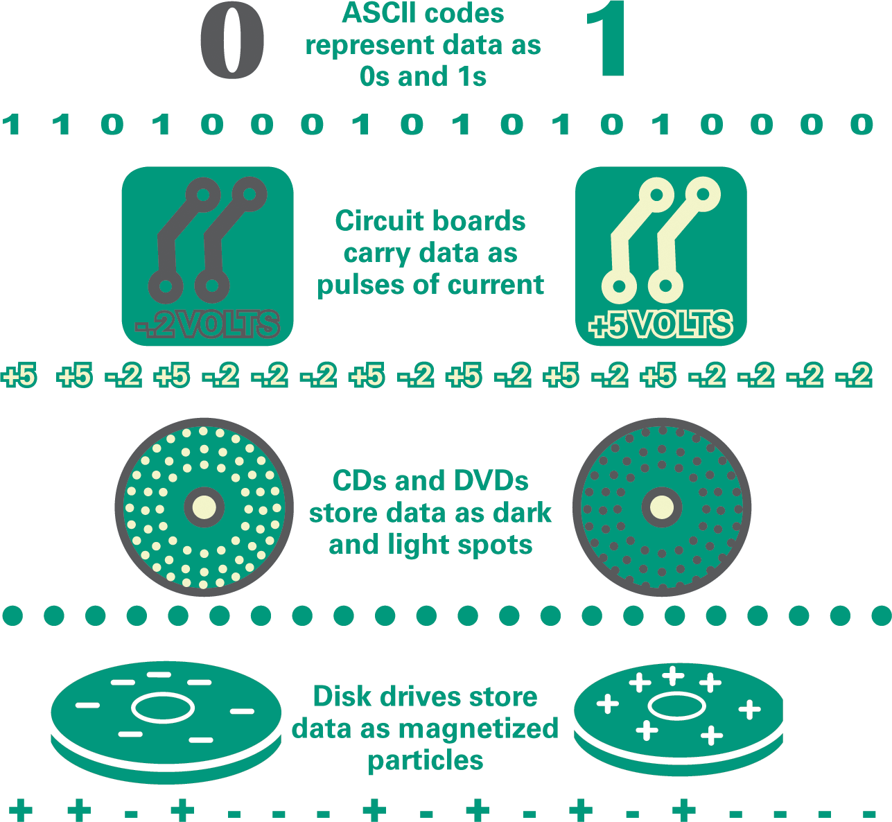
Data Representation Basics (4 of 4)

Slide 10
Representing Numbers (1 of 2)
Numeric data consists of numbers that can be used in arithmetic operations
Digital devices represent numeric data using the binary number system, also called base 2
The binary number system only has two digits: 0 and 1
No numeral like 2 exists in the system, so the number “two” is represented in binary as 10 (pronounced “one zero”)

Slide 11
Representing Numbers (2 of 2)
DECIMAL (BASE 10) | BINARY (BASE 2)
0 | 0
1 | 1
2 | 10
3 | 11
4 | 100
5 | 101
6 | 110
7 | 111
8 | 1000
9 | 1001
10 | 1010
11 | 1011
1000 | 1111101000

Slide 12
Representing Text (1 of 9)
Character data is composed of letters, symbols, and numerals that are not used in calculations
Examples of character data include your name, address, and hair color
Character data is commonly referred to as “text”

Slide 13
Representing Text (2 of 9)
Digital devices employ several types of codes to represent character data, including ASCII, Unicode, and their variants
ASCII (American Standard Code for Information Interchange, pronounced “ASK ee”) requires seven bits for each character
The ASCII code for an uppercase A is 1000001

Slide 14
Representing Text (3 of 9)
Extended ASCII is a superset of ASCII that uses eight bits for each character
For example, Extended ASCII represents the uppercase letter A as 01000001
Using eight bits instead of seven bits allows Extended ASCII to provide codes for 256 characters

Slide 15
Representing Text (4 of 9)
Unicode (pronounced “YOU ni code”) uses sixteen bits and provides codes or 65,000 characters
This is a bonus for representing the alphabets of multiple languages
UTF-8 is a variable-length coding scheme that uses seven bits for common ASCII characters but uses sixteen-bit Unicode as necessary

Slide 16
Representing Text (5 of 9)
00100000 | Space | 00110011 | 3 | 01000110 | F | 01011001 | Y | 01101100 | l
00100001 | ! | 00110100 | 4 | 01000111 | G | 01011010 | Z | 01101101 | m
00100010 | " | 00110101 | 5 | 01001000 | H | 01011011 | [ | 01101110 | n
00100011 | # | 00110110 | 6 | 01001001 | I | 01011100 | \ | 01101111 | o
00100100 | $ | 00110111 | 7 | 01001010 | J | 01011101 | ] | 01110000 | p
00100101 | % | 00111000 | 8 | 01001011 | K | 01011110 | ^ | 01110001 | q
00100110 | & | 00111001 | 9 | 01001100 | L | 01011111 | _ | 01110010 | r
00100111 | ' | 00111010 | : | 01001101 | M | 01100000 | ` | 01110011 | s
00101000 | ( | 00111011 | ; | 01001110 | N | 01100001 | a | 01110100 | t
00101001 | ) | 00111100 | < | 01001111 | O | 01100010 | b | 01110101 | u
00101010 | * | 00111101 | = | 01010000 | P | 01100011 | c | 01110110 | v
00101011 | + | 00111110 | > | 01010001 | Q | 01100100 | d | 01110111 | w
00101100 | , | 00111111 | ? | 01010010 | R | 01100101 | e | 01111000 | x
00101101 | - | 01000000 | @ | 01010011 | S | 01100110 | f | 01111001 | y
00101110 | . | 01000001 | A | 01010100 | T | 01100111 | g | 01111010 | z
00101111 | / | 01000010 | B | 01010101 | U | 01101000 | h | 01111011 | {
00110000 | 0 | 01000011 | C | 01010110 | V | 01101001 | i | 01111100 | |
00110001 | 1 | 01000100 | D | 01010111 | W | 01101010 | j | 01111101 | }
00110010 | 2 | 01000101 | E | 01011000 | X | 01101011 | k | 01111110 | ~

Slide 17
Representing Text (6 of 9)
ASCII codes are used for numerals, such as Social Security numbers and phone numbers
Plain, unformatted text is sometimes called ASCII text and is stored in a so-called text file with a name ending in .txt
On Apple devices these files are labeled “Plain Text.” In Windows, these files are labeled “Text Document”

Slide 18
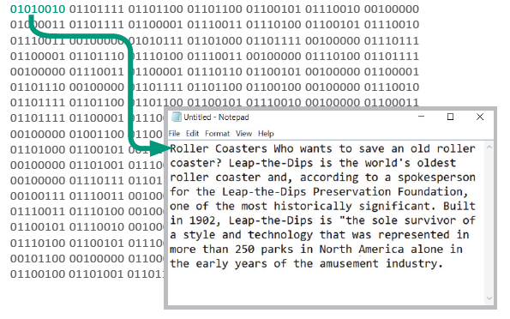
Representing Text (7 of 9)
ASCII text files contain no formatting
To create documents with styles and formats, formatting codes have to be embedded in the text

Slide 19
Representing Text (8 of 9)
Microsoft Word produces formatted text and creates documents in DOCX format
Apple Pages produces documents in PAGES format
Adobe Acrobat produces documents in PDF format
HTML markup language used for Web pages produces documents in HTML format

Slide 20
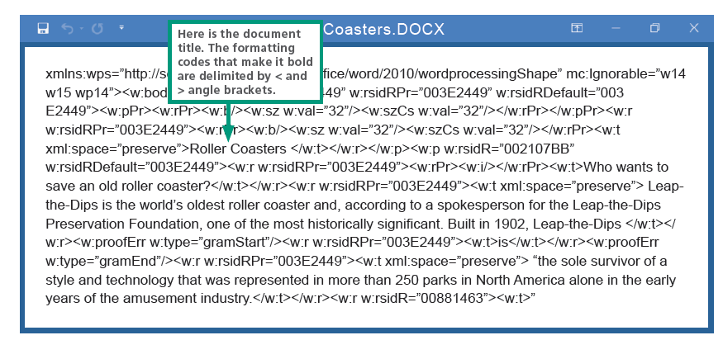
Representing Text (9 of 9)

Slide 21
Bits and Bytes (1 of 5)
All of the data stored and transmitted by digital devices is encoded as bits
Terminology related to bits and bytes is extensively used to describe storage capacity and network access speed
The word bit, an abbreviation for binary digit, can be further abbreviated as a lowercase b
A group of eight bits is called a byte and is usually abbreviated as an uppercase B

Slide 22
Bits and Bytes (2 of 5)
When reading about digital devices, you’ll frequently encounter references such as 90 kilobits per second, 1.44 megabytes, 2.8 gigahertz, and 2 terabytes
Kilo, mega, giga, tera, and similar terms are used to quantify digital data

Slide 23
Bits and Bytes (3 of 5)
Bit | One binary digit
Byte | 8 bits
Kilobit | 1,024 or 2¹⁰ bits
Kilobyte | 1,024 or 2¹⁰ bytes
Megabit | 1,048,576 or 2²⁰ bits
Megabyte | 1,048,576 or 2²⁰ bytes
Gigabit | 2³⁰ bits
Gigabyte | 2³⁰ bytes
Terabyte | 2⁴⁰ bytes
Petabyte | 2⁵⁰ bytes
Exabyte | 2⁶⁰ bytes

Slide 24
Bits and Bytes (4 of 5)
Use bits for data rates, such as Internet connection speeds, and movie download speeds
Use bytes for file sizes and storage capacities
56 Kbps: Kilobit (Kb or Kbit) can be used for slow data rates, such as a 56 Kbps (kilobits per second) dial-up connection.
104 KB: Kilobyte (KB or Kbyte) is often used when referring to the size of small computer files.
50 Mbps: Megabit (Mb or Mbit) is used for faster data rates, such as a 50 Mbps (megabits per second) Internet connection.

Slide 25
Bits and Bytes (5 of 5)
3.2 MB: Megabyte (MB or MByte) is typically used when referring to the size of files containing photos and videos.
100 Gbit: Gigabit (Gb or Gbit) is used for really fast network speeds.
16 GB: Gigabyte (GB or GByte) is commonly used to refer to storage capacity.

Slide 26
Compression (1 of 4)
To reduce file size and transmission times, digital data can be compressed
Data compression refers to any technique that recodes the data in a file so that it contains fewer bits
Compression is commonly referred to as “zipping”

Slide 27
Compression (2 of 4)
Compression techniques divided into two categories: lossless and lossy
Lossless compression provides a way to compress data and reconstitute it into its original state; uncompressed data stays exactly the same as the original data
Lossy compression throws away some of the original data during the compression process; uncompressed data is not exactly the same as the original

Slide 28
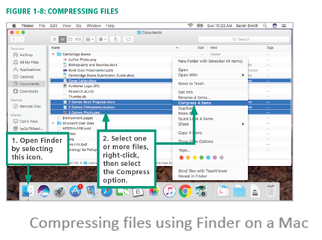
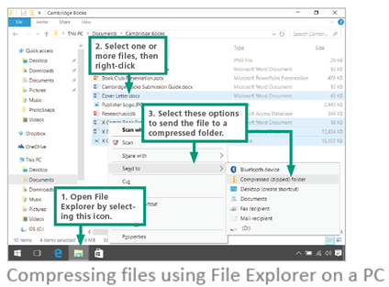
Compression (3 of 4)
Software for compressing data is sometimes referred to as a compression utility or a zip tool
On laptops and desktop computers, the compression utility is accessed from the same screen used to manage files

Slide 29
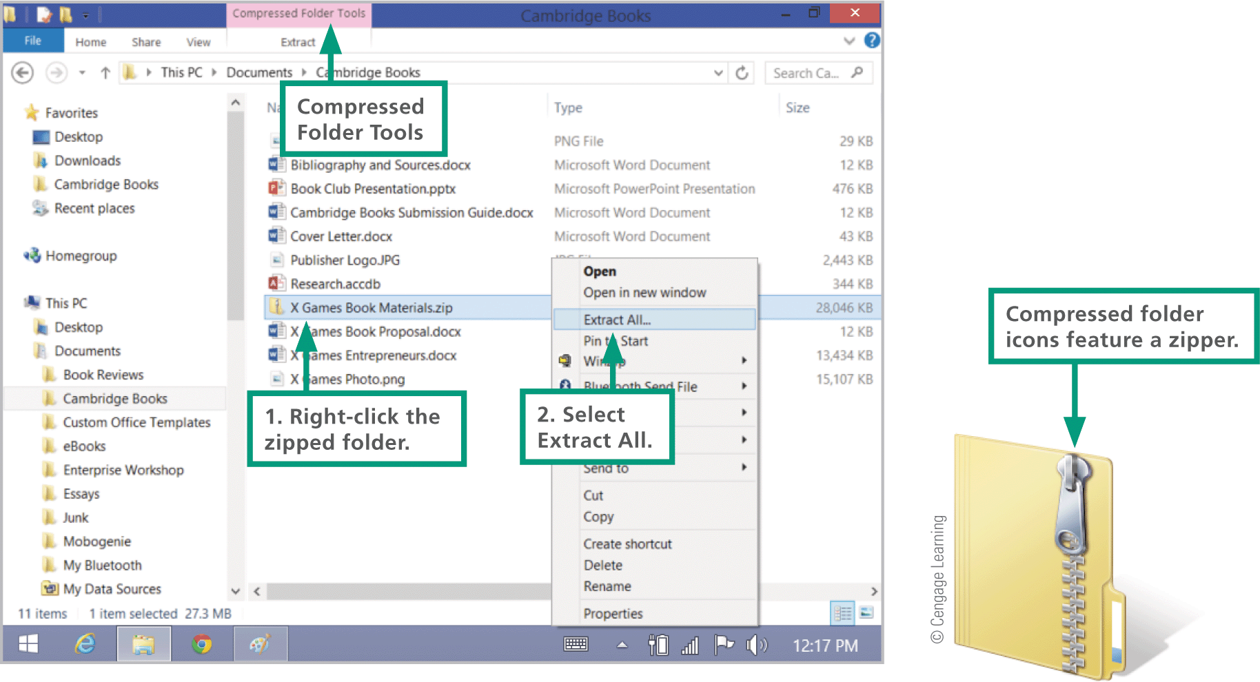
Compression (4 of 4)
The process of reconstituting files is called extracting or unzipping
Compressed files may end with a .zip, .gz, .pkg, or.tar.gz

Slide 30
Section B: Digital Sound
Digital Audio Basics
Digital Audio File Formats
MIDI
Digitized Speech

Slide 31
Section B: Objectives
Describe the process of digital sampling
Select the appropriate sampling rate for a digital audio recording
Identify digital audio files by their file name extensions
Convert digital audio files from one format to another
Understand why most audio files are compressed and how this affects sound quality
Decide when to download, live stream, or stream music on demand
Explain the difference between digital audio and MIDI
Explain how Siri and similar services work

Slide 32
Digital Audio Basics (1 of 3)
Digital audio is music, speech, and other sounds represented in binary format for use in digital devices
Most digital devices have a built-in microphone and audio software, so recording external sounds is easy
To digitally record sound, samples of a sound wave are collected at periodic intervals and stored as numeric data in an audio file
Sound waves are sampled many times per second by an analog-to-digital converter
A digital-to-analog converter transforms the digital bits into analog sound waves

Slide 33
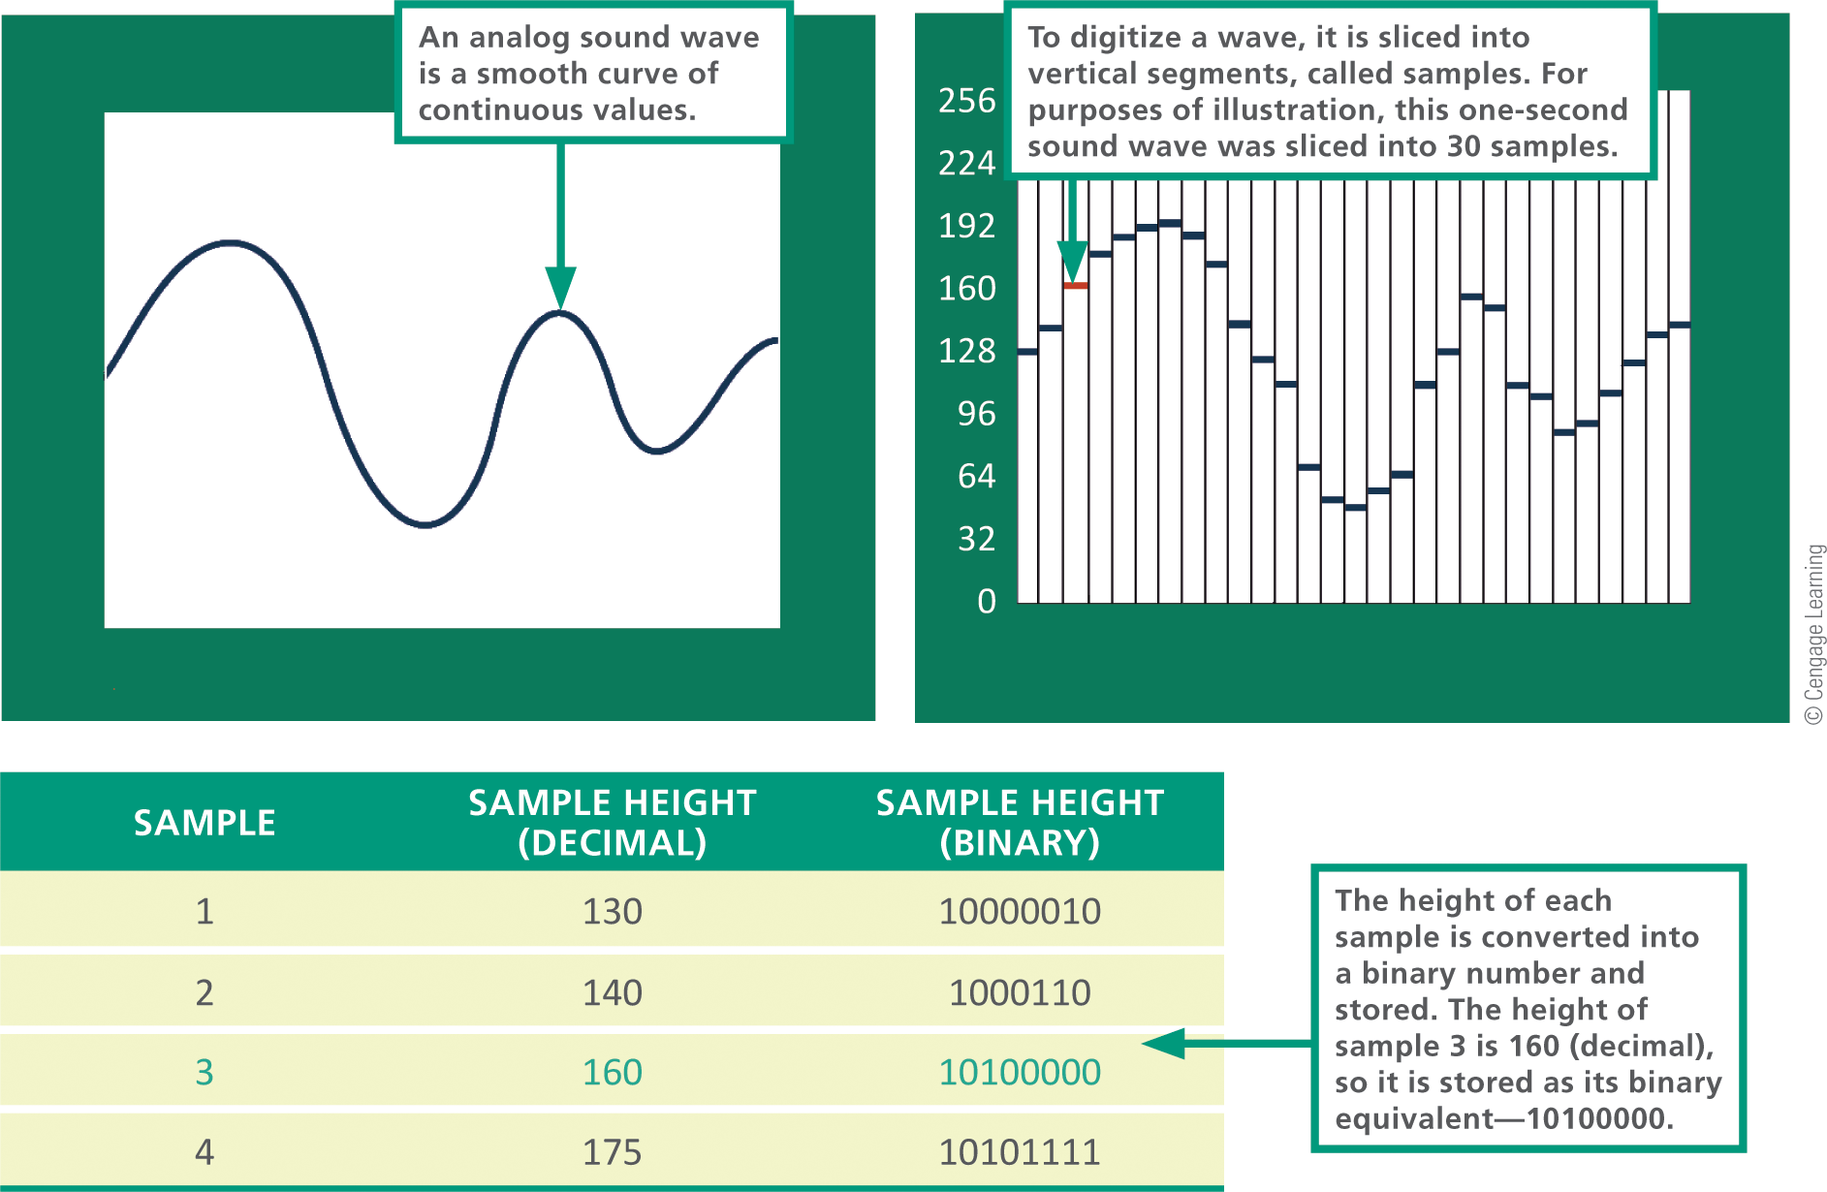
Digital Audio Basics (2 of 3)

Slide 34
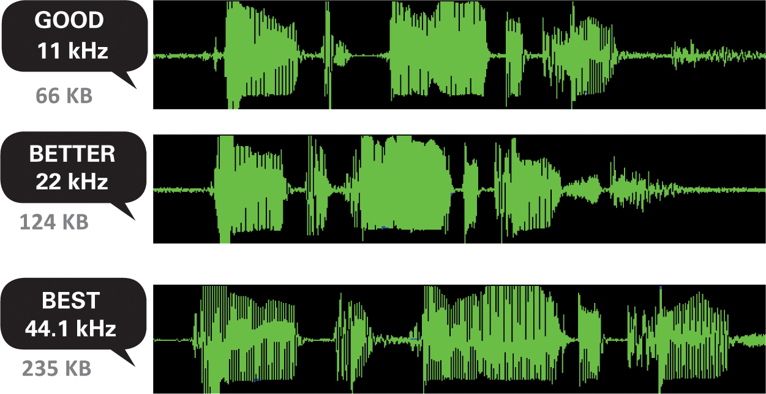
Digital Audio Basics (3 of 3)
Sampling rate refers to the number of times per second that a sound is measured during the recording process
Higher sampling rates increase the quality of the recording but require more storage space

Slide 35
Digital Audio File Formats (1 of 6)
A digital file can be identified by its type or its file extension, such as Thriller.mp3 (an audio file)
The most popular digital audio formats are: AAC, MP3, Ogg, Vorbis, WAV, FLAC, and WMA
AUDIO FORMAT | EXTENSION | ADVANTAGES | DISADVANTAGES
AAC (Advanced Audio Coding) | .aac, .m4p, or .mp4 | Very good sound quality based on MPEG-4; lossy compression; used for iTunes music | Files can be copy protected so that use is limited to approved devices
MP3 (also called MPEG-1 Layer 3) | .mp3 | Good sound quality; lossy compres­sion; can be streamed over the Web | Might require a standalone player or browser plugin
Ogg Vorbis | .Ogg | Free, open standard; lossy compres­sion; supported by some browsers | Slow to catch on as a popular standard; part of Google's WebM format

Slide 36
Digital Audio File Formats (2 of 6)
AUDIO FORMAT | EXTENSION | ADVANTAGES | DISADVANTAGES
WAV | .Wav | Good sound quality; supported in browsers without a plugin | Audio data is stored in raw, noncompressed format, so files are very large
FLAC (Free Lossless Audio Compression) | .flac | Excellent sound quality; lossless compression | Open source format support ported by many devices
WMA (Windows Media Audio) | .wma | Lossy or lossless compression; very good sound quality; used on several music download sites | Files can be copy protected; requires an add-on player for some devices

Slide 37
Digital Audio File Formats (3 of 6)
Ripping is a slang term that refers to the process of importing tracks from a CD or DVD to your computer’s hard disk
The technical term for ripping music tracks is digital audio extraction
A download copies a file from a private network or Internet server to a local device
Audio files can be acquired as a live stream or on-demand stream in addition to downloads

Slide 38
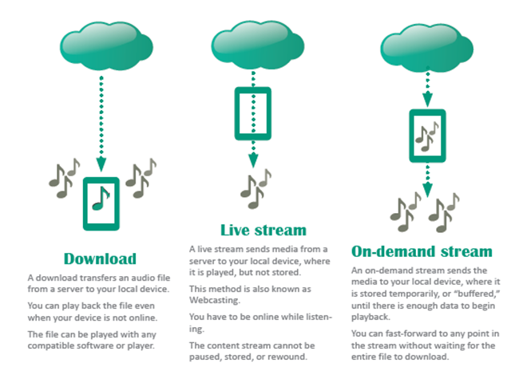
Digital Audio File Formats (4 of 6)

Slide 39
Digital Audio File Formats (5 of 6)
To play a digital audio file, you must use some type of audio software, such as:
Audio players: small standalone software application or mobile app that offers tools for listening to digital audio and managing playlists, typically included with your computer’s OS (operating system)
Audio plugins: software that works in conjunction with your computer’s browser to manage and play audio from a Web page
Audio software: general-purpose software and apps used for recording, playing, and modifying audio files, such as iTunes, Windows Media Player, and Audacity

Slide 40
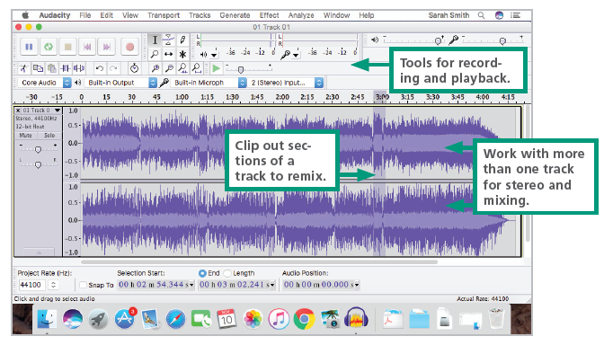
Digital Audio File Formats (6 of 6)

Slide 41
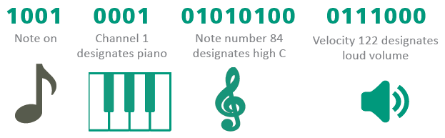
MIDI (1 of 2)
MIDI (Musical Instrument Digital Interface) specifies a standard way to store music data for synthesizers, electronic MIDI instruments, and computers
MIDI messages are instructions that specify the pitch of a note, the point at which the note begins, the volume of the note, etc.
An MIDI message may look like this:

Slide 42
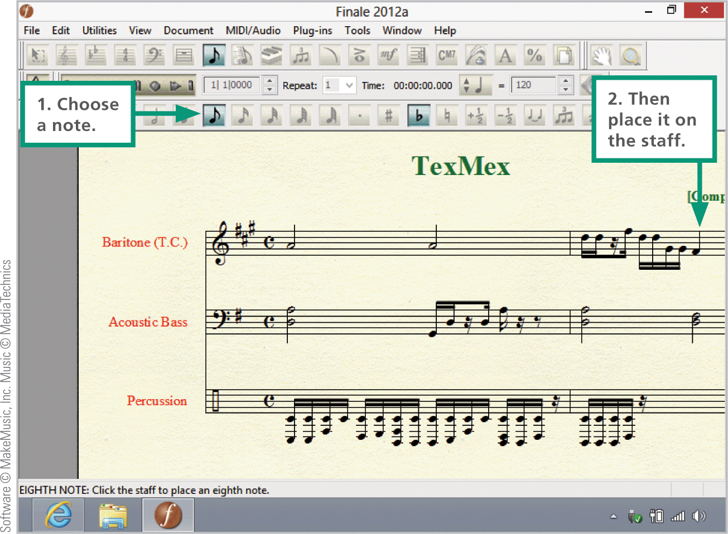
MIDI (2 of 2)
Music composition software with MIDI support makes it easy to place notes on a screen-based music staff then play back the composition on a MIDI keyboard or through the speakers of a digital device

Slide 43
Digitized Speech (1 of 2)
Speech synthesis is the process by which machines produce sound that resembles spoken words
Speech recognition (or voice recognition) refers to the ability of a machine to understand spoken words
Speech recognition software analyzes the sounds of your voice and converts each word into groups of phonemes (basic sound units)
The software then compares the groups to the words in a digital dictionary to find a match
When a match is found, the software can display the word on the screen or use it to carry out a command

Slide 44
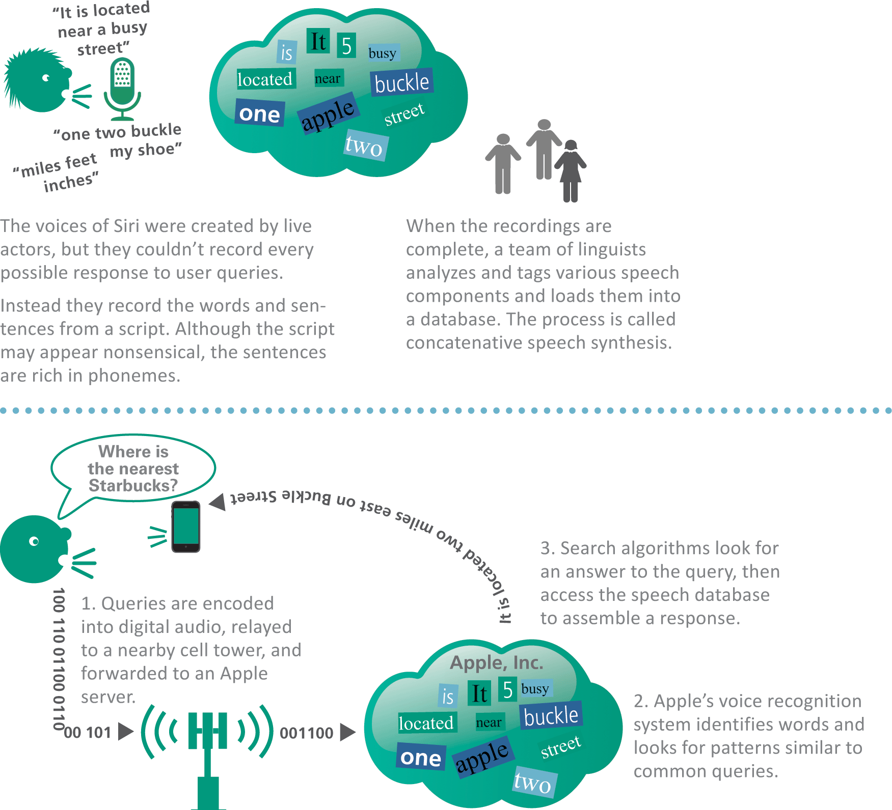
Digitized Speech (2 of 2)

Slide 45
Section C: Bitmap Graphics
Bitmap Basics
Bitmap Data Representation
Image Compression
Modifying Bitmap Images
Panoramic and 360 Images
Stereoscopy

Slide 46
Section C: Objectives (1 of 2)
Describe the differences between bitmap and vector graphics file formats
Explain how pixel color is represented in decimal, hexadecimal, and binary
Calculate the size of a bitmap file given its resolution
Decide which graphics format to use for school, work, or personal projects
Describe how cameras and scanners produce digital images
Explain how 3D images are created

Slide 47
Section C: Objectives (2 of 2)
Describe the RGB and CMYK color models
Explain what a color histogram represents and how to use one
Provide examples of image stitching
Describe two types of stereoscopic imaging

Slide 48
Bitmap Basics (1 of 6)
As digital devices gained the ability to display images, two types of computer graphics evolved: bitmap and vector
A bitmap graphic is composed of a grid of tiny rectangular cells
Each cell is a picture element, commonly called a pixel
Each pixel is assigned a color, which is stored as a binary number

Slide 49
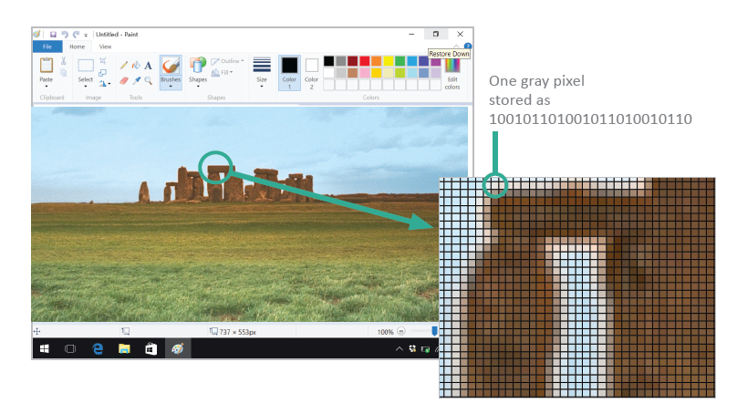
Bitmap Basics (2 of 6)

Slide 50
Bitmap Basics (3 of 6)
You can create a bitmap graphic from scratch using the tools provided by graphics software — specifically a category of graphics software referred to as paint software
Examples of paint software are Adobe Photoshop, Apple Photos, and Microsoft Paint

Slide 51
Bitmap Basics (4 of 6)
You can use a scanner to convert a printed image into a bitmap graphic
A scanner divides an image into a fine grid of cells and assigns a digital value for the color of each cell
As a scan progresses, the values are transferred to a digital device and stored as a bitmap graphics file

Slide 52
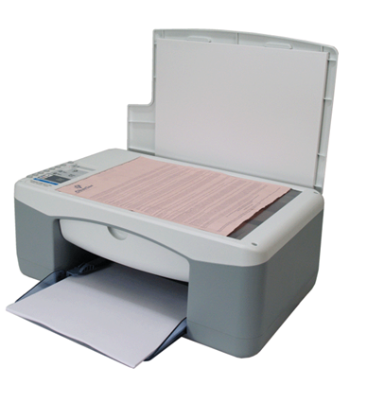
Bitmap Basics (5 of 6)
To scan an image, turn on the scanner and start your scanner software. Place the image face down on the scanner glass, then use the scanner software to initiate the scan. The scanned image is saved in memory and can then be saved on your computer’s hard disk or in another storage location.

Slide 53
Bitmap Basics (6 of 6)
In a digital camera, the lens focuses light from the image onto a small image sensor called a CCD (charge-coupled device)
A CCD contains a grid of tiny light-sensitive diodes called photosites
Photosites correspond to pixels; the more pixels used to capture an image, the higher its resolution
Cameras, scanners, and graphics software offer a choice of bitmap formats, such as BMP, RAW, TIFF, JPEG, GIF, and PNG

Slide 54
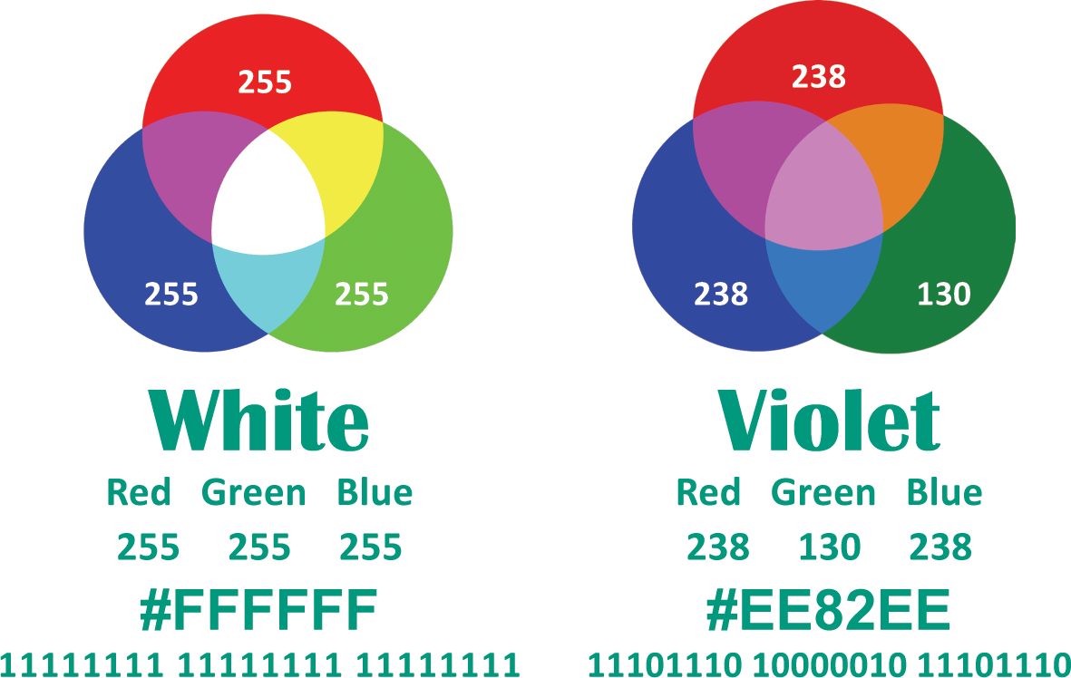
Bitmap Data Representation (1 of 3)
Color and resolution are key elements in bitmap data representation
Today’s color display devices represent color using the RGB color model
Look at the center where the circles intersect to see the color that is generated. Color numbers are shown in decimal, hexadecimal, and binary.

Slide 55
Bitmap Data Representation (2 of 3)
Color values can be specified in decimal (base 10), hexadecimal (base 16), or binary (base 2)
With 8 bits used to represent each color value, one pixel requires 24 bits
The number of colors available in a graphic is referred to as color depth
The dimensions of the grid that forms a bitmap graphic are referred to as image resolution
High-resolution graphics contain more data than low-resolution graphics; more data makes it possible to display and print high-quality images that are sharper and clearer

Slide 56
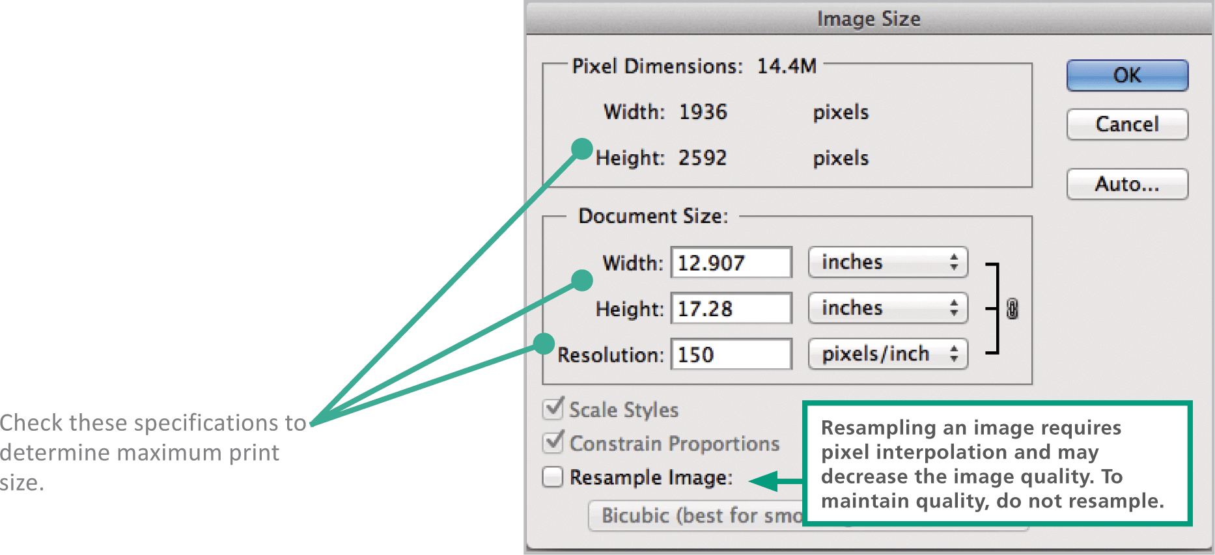
Bitmap Data Representation (3 of 3)
Graphics software, such as Adobe Photoshop, can help you gauge how large an image can be printed before the quality begins to deteriorate

Slide 57
Image Compression (1 of 2)
Image compression refers to any technique that recodes the data in an image file so that it contains fewer bits
Run-length encoding (RLE) is a type of lossless compression that replaces a series of similarly colored pixels with a binary code that indicates the number of pixels and their colors

Slide 58
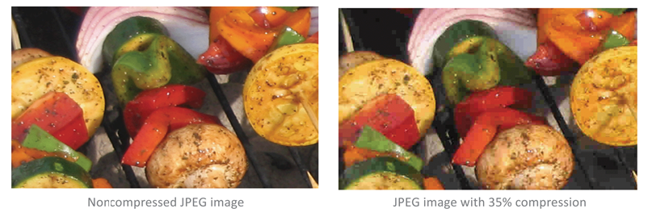
Image Compression (2 of 2)
Lossy compression techniques discard some data from an image to shrink its file size
For many images, lossy compression results in only a minor reduction in the sharpness of the images

Slide 59
Modifying Bitmap Images (1 of 2)
Photoshop software and a host of local and online apps make it easy to modify digital images
Photoediting software includes sophisticated tools based on graphics algorithms that produce amazing transformations of digital images

Slide 60
Modifying Bitmap Images (2 of 2)
Characteristics of bitmap that can be modified:
Noise reduction – “noise” refers to spots, dust, and scratches left on old photos after they are scanned
Image enhancement – improves brightness, color saturation, and focus
Selective color change – algorithms are used to colorize black and white photos
Correcting image distortion – reconstructing perspective with photoediting
Cloning – employs algorithms pulling pixels from one area and moving them to another
Inpainting – reconstructing lost or unwanted areas in a photo
Digital compositing – assembling more than one image into one by using clipping paths and alpha bending

Slide 61
Panoramic and 360 Images (1 of 3)
Photos are no longer limited to flat rectangles; gone beyond the box to become panoramic views, 360-degree images, and immersive photo spheres
These image formats are made possible by a technology called image stitching
Image stitching (or photo stitching) creates a panoramic image by combining two or more separate photographs that have overlapping edges
The photos are captured from a fixed location
Stitching uses photos in standard bitmap formats, such as JPEG and PNG

Slide 62
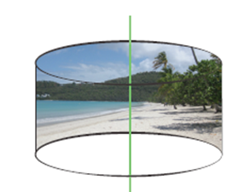


Panoramic and 360 Images (2 of 3)
Rectilinear projections are viewed in a two-dimensional plane, typically as a long horizontal photo. These images can be produced using the panoramic feature of a digital camera.
Cylindrical projections produce a 360-degree image similar to the view from a merry-go-round. Images are captured from the front, back, and sides, and then stitched together.
Spherical projections include images from the 360-degree vertical view as well as the 360-degree horizontal panorama.

Slide 63
Panoramic and 360 Images (3 of 3)
A series of photos can be manually stitched together using software, such as Autopano and AutoStitch, but many digital cameras take care of stitching automatically
Apps, such as Google Street View and Photo Sphere, guide photographers through the rotational process to capture a 360-degree view, which is then stitched together into a continuous image.
Special cameras are also available for capturing and stitching photos for cylindrical and spherical projections

Slide 64
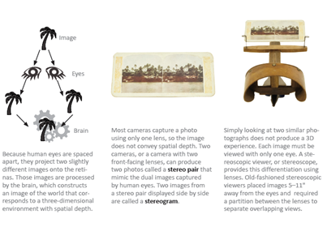
Stereoscopy (1 of 3)
Stereoscopic imaging (or stereoscopy) is a graphical technique used to produce an illusion of spatial depth from flat, two-dimensional images

Slide 65
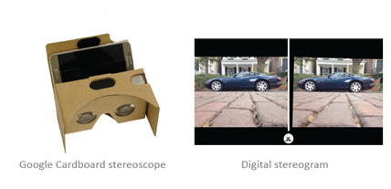
Stereoscopy (2 of 3)
Modern stereoscopic imaging uses digital images and viewers
A stereoscopic viewer, such as Google Cardboard, displays images generated by mobile devices

Slide 66
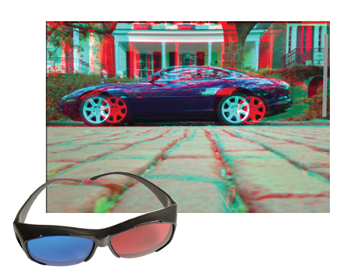
Stereoscopy (3 of 3)
An anaglyph is a graphic composed of two images, one that is tinted red and the other that is tinted blue
Viewing anaglyph images requires red-green or red-blue glasses
Usually, the red lens on the left filters out blue and green, while the blue- or green-colored lens on the right filters out red

Slide 67
Section D: Vector Graphics
Vector Graphics Basics
Vector Tools
3D Graphics
Vectors and Virtual Reality

Slide 68
Section D: Objectives (1 of 2)
Identify vector graphics used on Web sites and social media
Based on the characteristics of vector graphics, determine when they are more suitable for a project than bitmaps
Draw simple vector shapes and outlines using drawing software
Convert a vector drawing into a bitmap
Explain the process of rendering a 3D wireframe into an image

Slide 69
Section D: Objectives (2 of 2)
Identify the key difference between rendering 3D graphics for computer games and creating special effects for movies
Explain how vector graphics relate to augmented reality
Describe the type of graphics commonly used for virtual reality

Slide 70
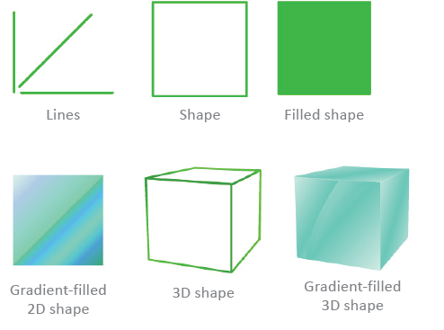
Vector Graphics Basics (1 of 3)
The first graphics that appeared on computer screens were not photos, but simple shapes consisting of lines and curves, each referred to as a vector

Slide 71
Vector Graphics Basics (2 of 3)
A vector graphic consists of a set of instructions for creating a picture
Vector graphics include standard shapes such as circles and rectangles
Vector Graphics vs. Bitmap Images
Resize better than bitmaps
Require less storage space
Not as realistic as bitmap images
Editing an object is easier than in bitmap

Slide 72
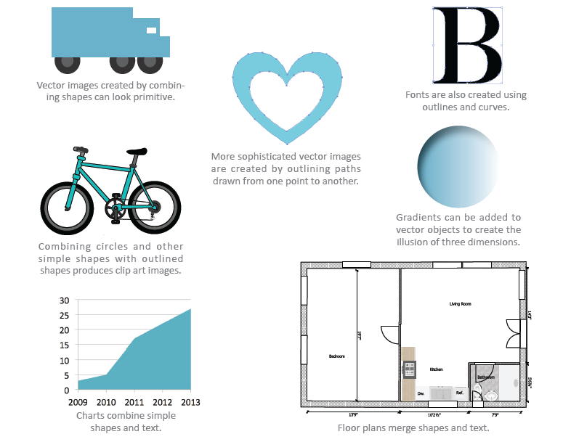
Vector Graphics Basics (3 of 3)
Vector graphics are used for floor plans, engineering diagrams, and spreadsheet charts

Slide 73
Vector Tools
Vector graphics are created from scratch using drawing software such as:
Adobe Illustrator
LibreOffice Draw
Open source Inkscape
Various vector drawing apps

Slide 74
3D Graphics (1 of 4)
3D graphics are based on vectors stored as a set of instructions describing the coordinates for lines and shapes in a three-dimensional space
Vectors form a wireframe that works like the framework for a tent
The process of covering the wireframe surface with color and texture is called rendering
The technique for adding light and shadows to a 3D image is called ray tracing

Slide 75
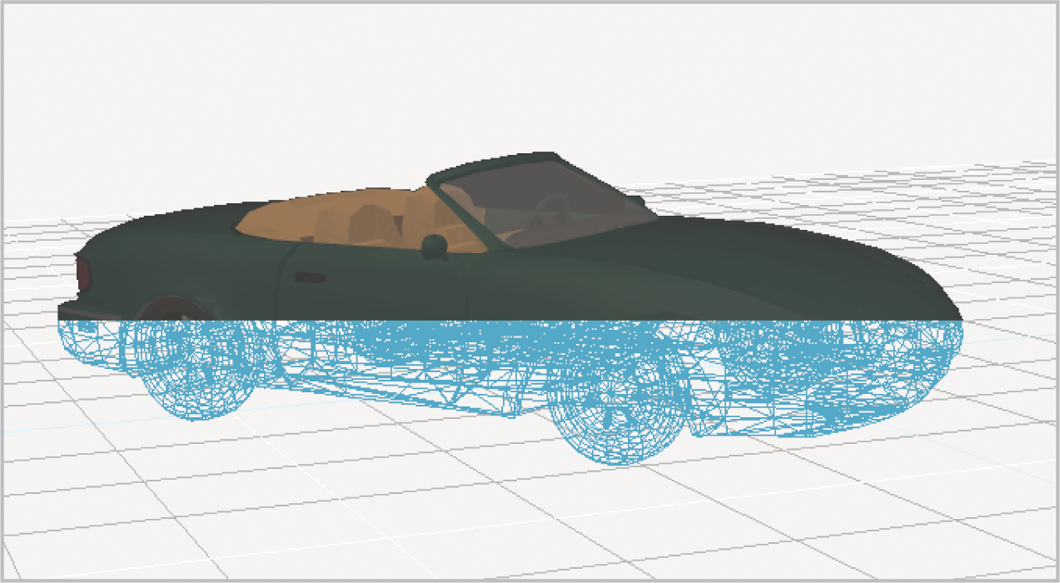
3D Graphics (2 of 4)

Slide 76
3D Graphics (3 of 4)
A 3D vector image may have a three-dimensional appearance, but as a single image, it cannot convey visual depth
A 3D-rendered image can be modified to create a second rendering slightly offset from the original
A smartphone camera captures an image of the real world, and then a game character is rendered onto that image
The composite image is output to the smartphone screen

Slide 77
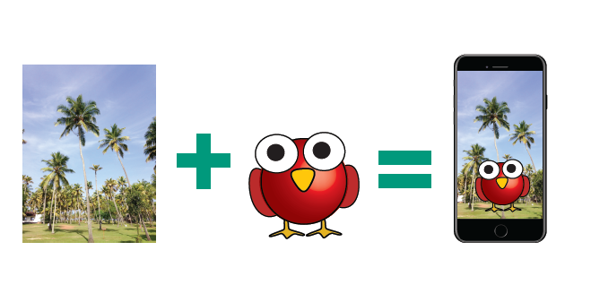
3D Graphics (4 of 4)

Slide 78

Vectors and Virtual Reality (1 of 3)
A vector animation is a type of motion graphic in which a series of vector images is displayed sequentially to convey the illusion of movement
Each image is called a frame

Slide 79
Vectors and Virtual Reality (2 of 3)
The process of rendering vector-based frames and packaging them into a digital movie file is called pre-rendering
Pre-rendering is used to create special effect sequences for films, as well as full-length animated movies; these pre-rendered clips are referred to as CGI (computer-generated imagery)
Real-time rendering fills in wireframe objects and generates a bitmap image as the action unfolds

Slide 80
Vectors and Virtual Reality (3 of 3)
Most interactive virtual reality visuals are generated from 3D vector graphics and displayed on VR headsets, such as Google Cardboard and Oculus Rift
A game engine is graphics software that allows developers to create interactive videogames and educational modules

Slide 81
Section E: Digital Video
Digital Video Basics
Video Compression
Video File Formats
Digital Video Variations

Slide 82
Section E: Objectives (1 of 2)
Recognize digital video files by their file name extensions
List the video formats that are commonly used on the following: YouTube, iPhone, Android phone, television, Web browsers
List devices and other sources that are commonly used to capture video footage
List factors that affect the size and quality of digital videos

Slide 83
Section E: Objectives (2 of 2)
Explain the contents of a video container
Differentiate between interlaced and progressive scan
State the most commonly used aspect ratios on the following: iPhone screen, iPad screen, YouTube, Windows laptop computer screen
Explain the purpose of a codec
List the variety of videos that originate as bitmap graphics

Slide 84
Digital Video Basics (1 of 10)
Digital video uses bits to store color and brightness data for each video frame, a process similar to storing the data for a series of bitmap images in which the color of each pixel is represented by a binary number
Footage from Super 8 home movies, VHS tapes, and other older sources can be digitized using video capture equipment
You can shoot footage for digital video with:
A consumer-quality camcorder
A webcam
A smartphone camera

Slide 85
Digital Video Basics (2 of 10)
Digital cinematography is used in the motion picture industry; it captures moving images as bits, rather than on film
Digital video is a core technology for digital television, videoconferencing systems, and video messaging

Slide 86
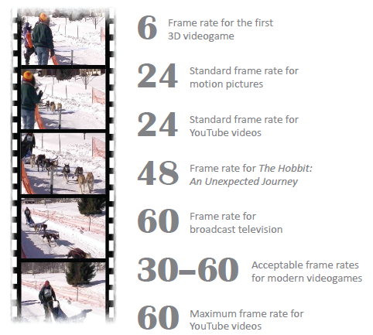
Digital Video Basics (3 of 10)
Digital video displays bitmap images in rapid succession
Each bitmap image is referred to as a frame
The number of frames that are displayed per second is the frame rate (fps)

Slide 87
Digital Video Basics (4 of 10)
Video resolutions can be expressed as width x height, as the horizontal resolution, or as the vertical resolution
Cameras used for digital cinematography capture video with a resolution of 2048 x 1536
This resolution is referred to as 2K because the horizontal resolution is about 2,000 pixels

Slide 88
Digital Video Basics (5 of 10)
Vertical resolutions are expressed with a “p” for progressive scan, in which the frame is drawn line by line in sequence from top to bottom
An interlaced scan is a contrasting scanning technique that produces an image by drawing every other line, then going back and filling in the in-between lines
Digital video for computers typically uses progressive scanning; digital television uses interlaced scanning

Slide 89
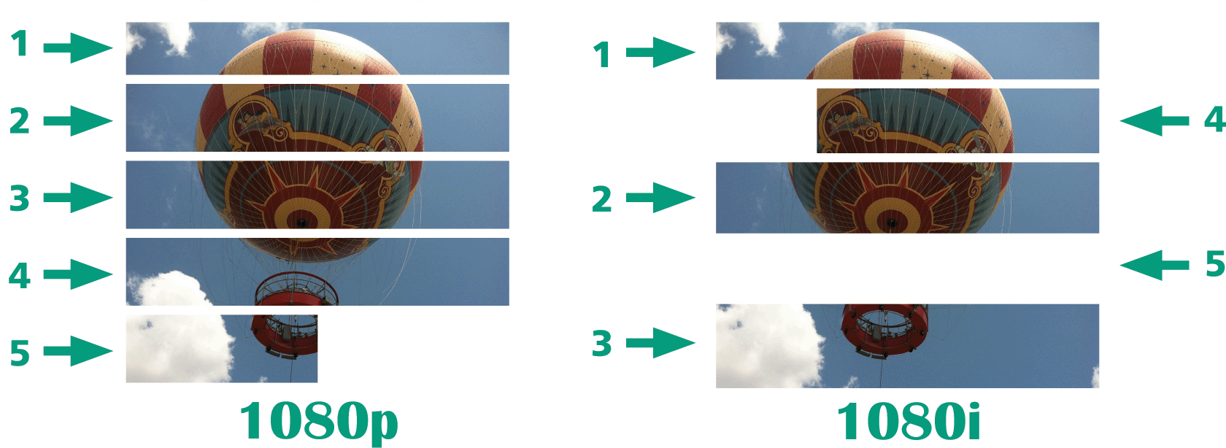
Digital Video Basics (6 of 10)

Slide 90
Digital Video Basics (7 of 10)
Aspect ratio is the proportional relation between the width and height of an image or video frame
iPads use a 4:3 aspect ratio
Widescreen devices, such as laptops and smartphones, use a 16:9 aspect ratio

Slide 91
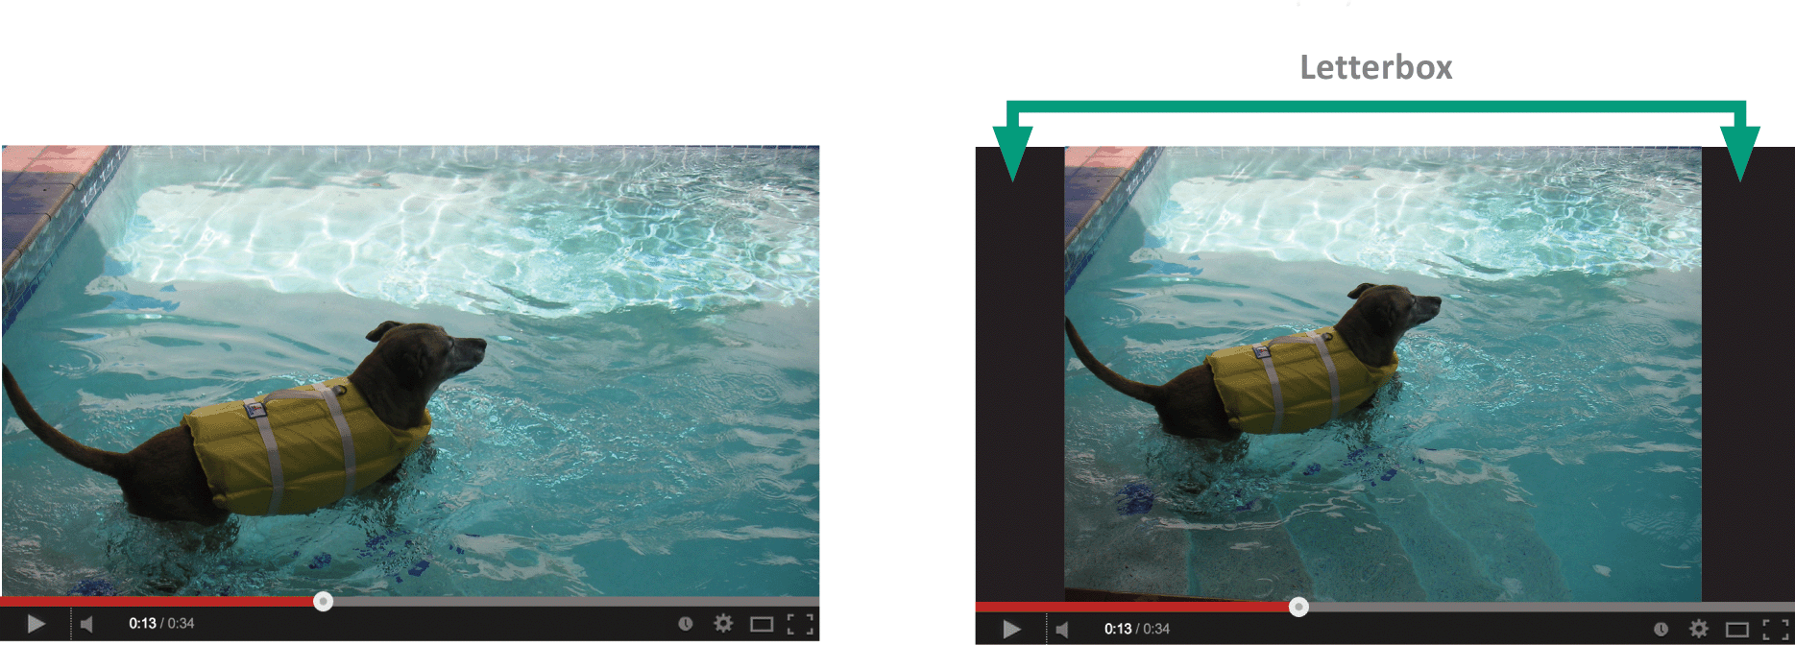
Digital Video Basics (8 of 10)
When 4:3 videos are displayed on a widescreen player, they are bordered by the black bars of a letterbox
The video on the left has a 16:9 aspect ratio that fits into the YouTube player window. The video on the right has a 4:3 aspect ratio. A letterbox creates black bars to fill the playback window.

Slide 92
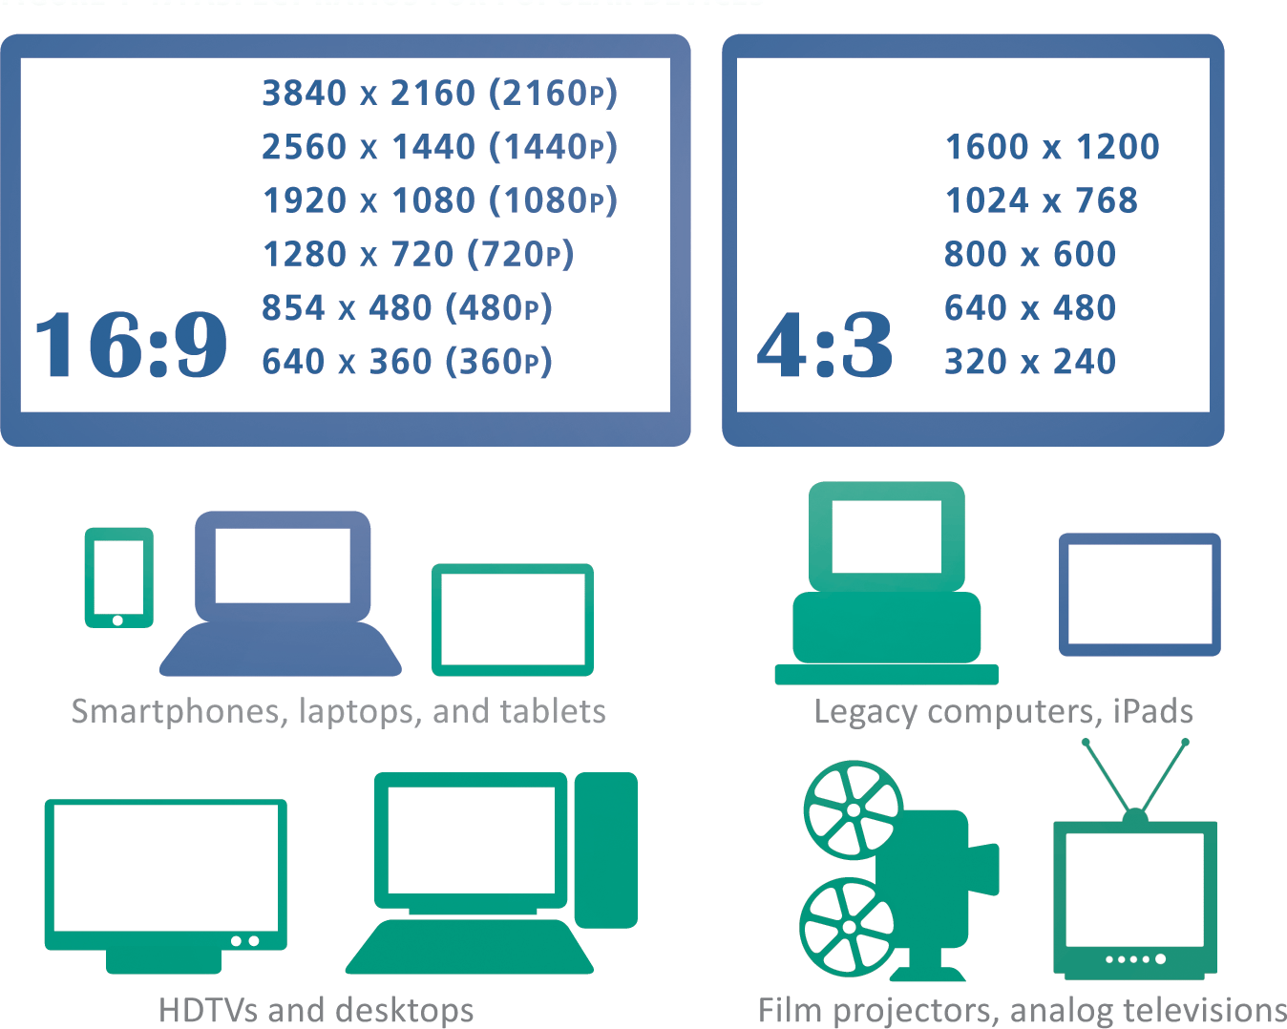
Digital Video Basics (9 of 10)

Slide 93
Digital Video Basics (10 of 10)
1,194,393,600 bits are needed for one second of digital video
A feature-length video requires an astounding 8,599,633,920,000 bits! More than one trillion bytes!
A bit rate is the number of bits that are processed during a specific unit of time, usually during one second
Bit rate can be expressed as bits per second (b/sec or bps) and kilobits per second (Kbit/s or Kbps)

Slide 94
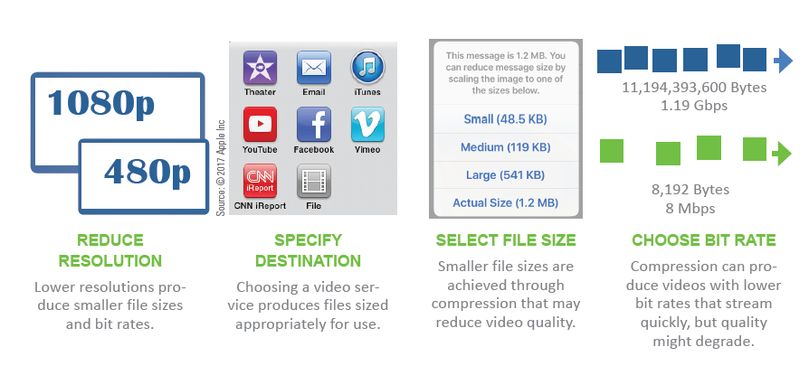
Video Compression (1 of 3)
Choosing a lower resolution when saving a video reduces the bit rate

Slide 95
Video Compression (2 of 3)
Compression removes some of the data (bits) through the following techniques:
Compressor/decompressor software
Image compression – frames of a video are compressed using lossy and lossless compression
Interframe compression – stores only the pixels that change color from one frame to the next
A codec (compressor/decompressor) is the software that compresses a video stream when a video is stored and decompresses the file when the video is played

Slide 96
Video Compression (3 of 3)
Each codec uses a unique algorithm to shrink the size of a video file, so they are not interchangeable
Popular codecs include: MPEG, VP8, DivX, H.264, Theora, and Windows Media Video

Slide 97
Video File Formats (1 of 4)
Video files are stored in container formats that hold the compressed video stream and an audio stream
AVI, MOV, MPEG, WebM, ASF, VOB, and Ogg Theora are popular video container formats

Slide 98
Video File Formats (2 of 4)
FORMAT | EXTENSION | PLATFORM | DESCRIPTION AND USE
MPEG (Moving Picture Experts Group) | .mpg, .mp4, .mpeg | PC, Mac, UNIX, Linux | Versions include MPEG-1, MPEG-2, and MPEG-4; used for downloaded and streaming Web video
WebM | .webm | PC, Mac, UNIX, Linux | Royalty-free, high-quality open format for use with HTML5
AVI (Audio Video Interleave) | .avi | PC | A format sometimes used for storing digital clips from video cameras; used for legacy video on the PC platform
MOV (QuickTime Movie) | .mov | PC, Mac, UNIX, Linux | A legacy format for downloaded and Streaming Web videos
ASF (Advanced Systems Format) | .asf, .wmv | PC | Container format for Microsoft’s Windows Media Video (WMV); supports downloads and streaming
VOB (Video Object) | .vob | Standalone DVD player, PC, Mac, Linux | Industry-standard format for standalone DVD players
Ogg Theora | .ogg | PC, Mac | A non-proprietary container (Ogg) and video codec (Theora)

Slide 99
Video File Formats (3 of 4)
Digital videos can be converted from one format to another through a process called transcoding
Basic video editing tools are used to arrange video clips, add a soundtrack, insert captions, select special effects such as fades between clips, and choose output format

Slide 100
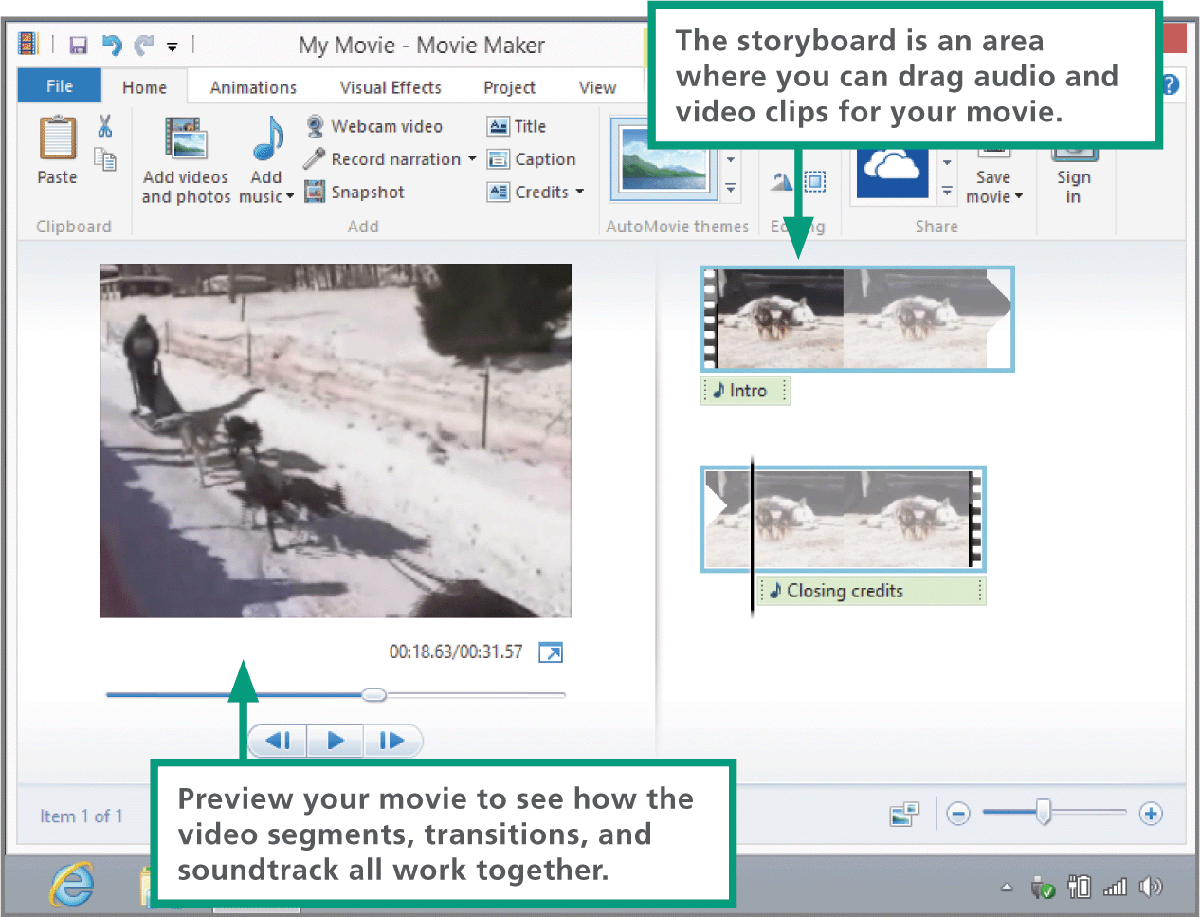
Video File Formats (4 of 4)

Slide 101
Digital Video Variations (1 of 2)
Movies are simply multiframe bitmaps that build on techniques used to create basic bitmap still images
A photographer uses multiple video cameras to simultaneously film footage from all angles
A 360-degree video is a motion graphic that depicts continuous events happening within a 360-degree radius or sphere of a single pivot point

Slide 102
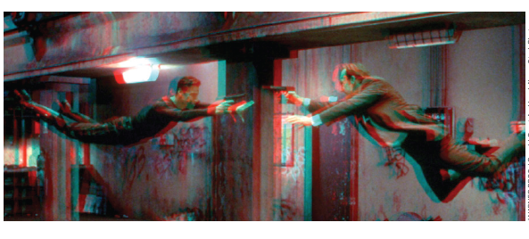
Digital Video Variations (2 of 2)
Movies that appear to have visual depth are commonly called “3D,” but technically, they are stereoscopic
When movies are constructed with anaglyphs, each frame contains a blue and red stereo pair. Viewers wear glasses with red and blue lenses to experience the effect of visual depth

